Slide 1
Sales Performance Analysis
Presented by Nehasri M

Slide 2
Introduction
Title : Sales Performance Analyzing
Company: ABC Electronics Domain: Retail Sales Analytics Tool: Microsoft Excel

Slide 3
Problem Statement
ABC Electronics needs to understand its sales performance across regions and product categories and identify the areas that require attention for better business decisions.
Project Objective
Analyze regional and product-wise sales performance
Identify top-performing regions and categories
Understand sales, profit, quantity and discount patterns
Build an interactive Excel dashboard

Slide 4
Business Use Cases & Objectives
Region Performance
Product Performance
Profitability & Discounts
Sales Trends
Business Decision Support

Slide 5
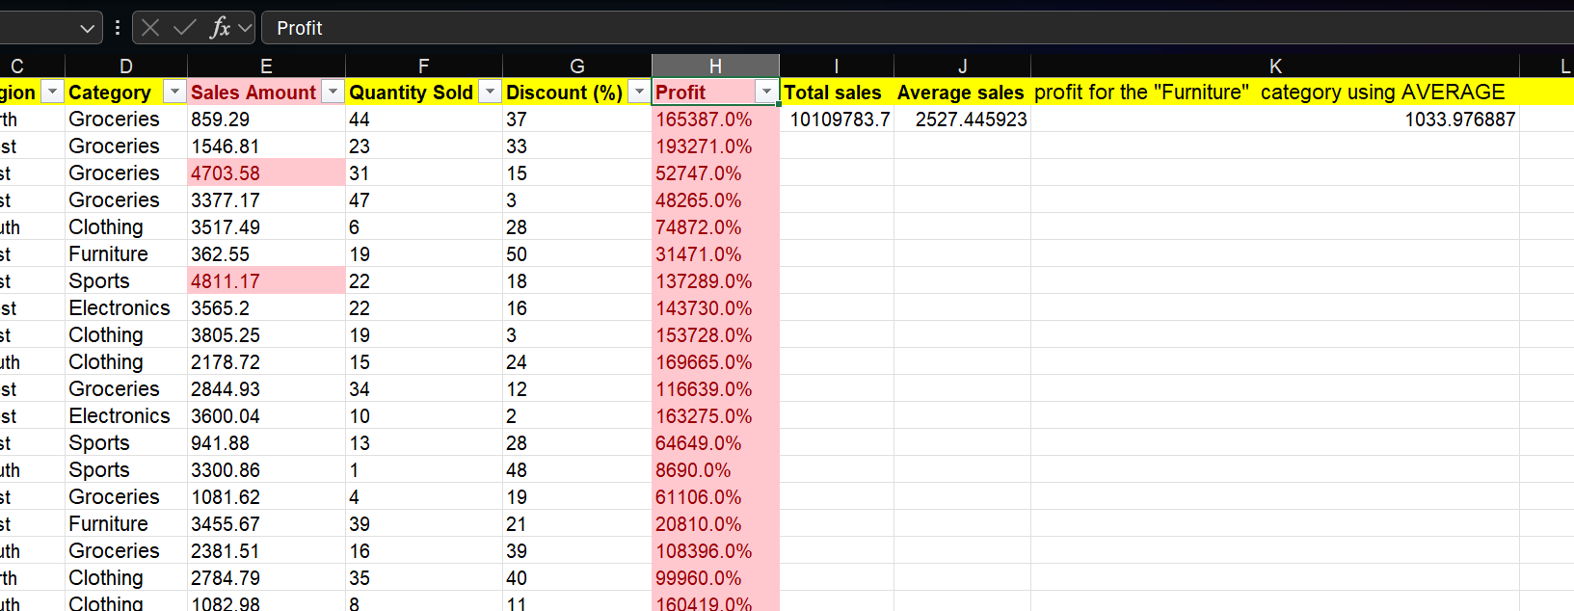
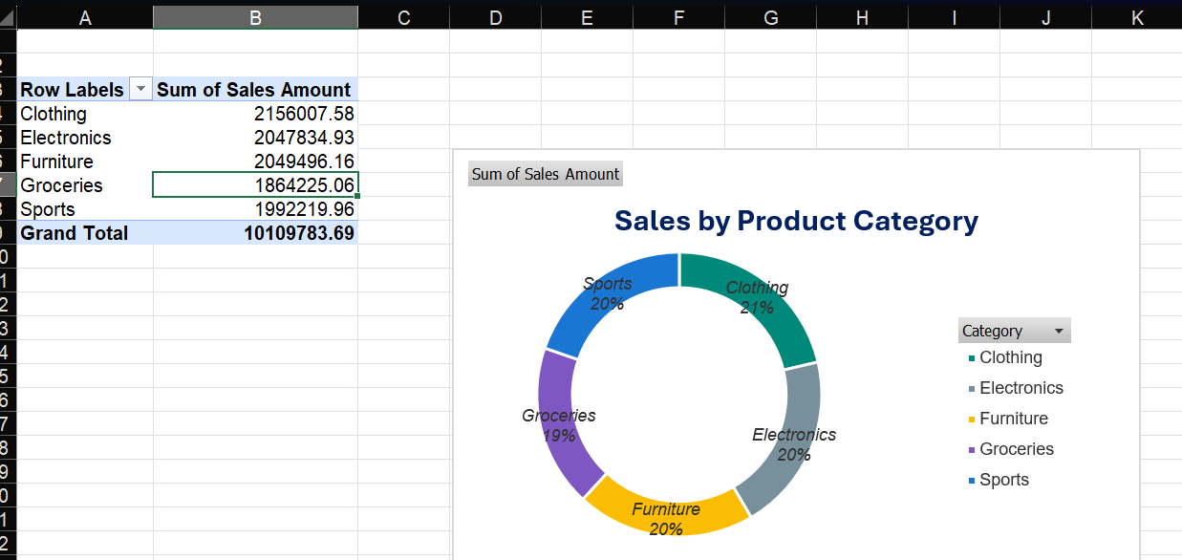
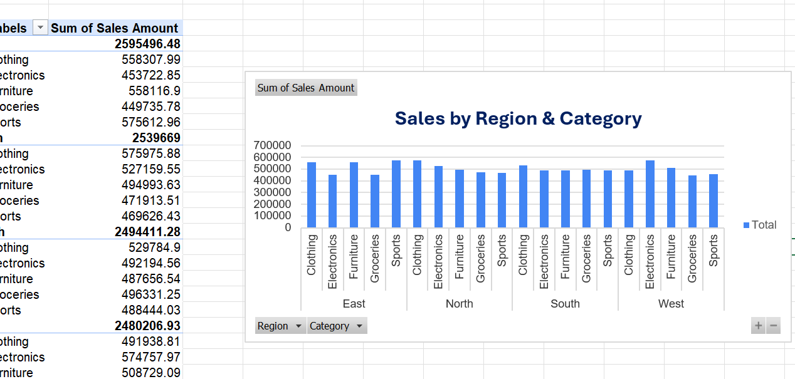
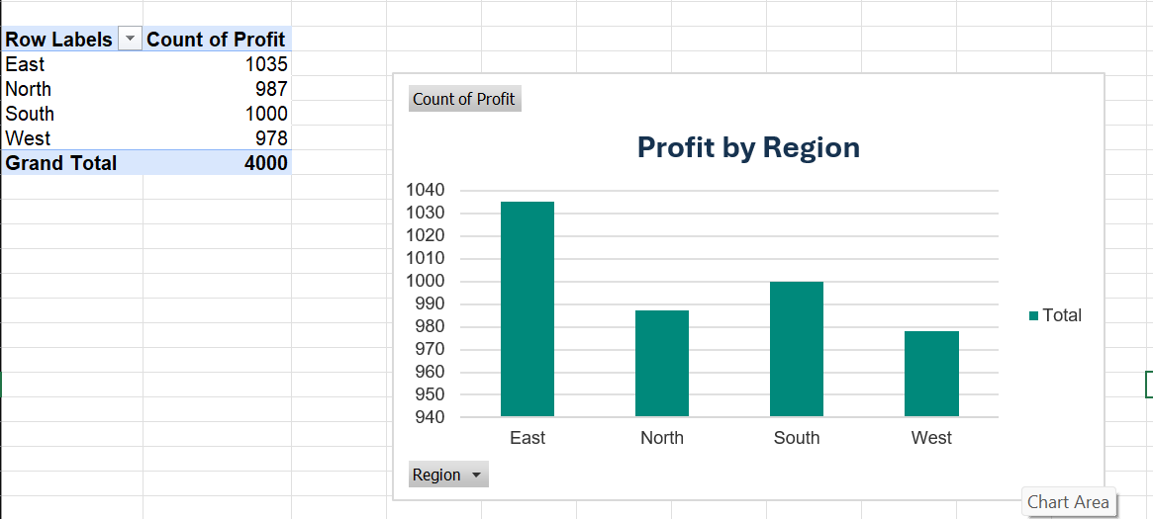
Analytical Approach
1. DATA PREPARATION
Collect → Clean → Organize
2. EXPLORATORY ANALYSIS
Explore → Compare → Identify
3. DATA VISUALIZATION
Transform Data → Visual Insights
4. INSIGHT & DECISION
Interpret → Evaluate → Recommend

Slide 6
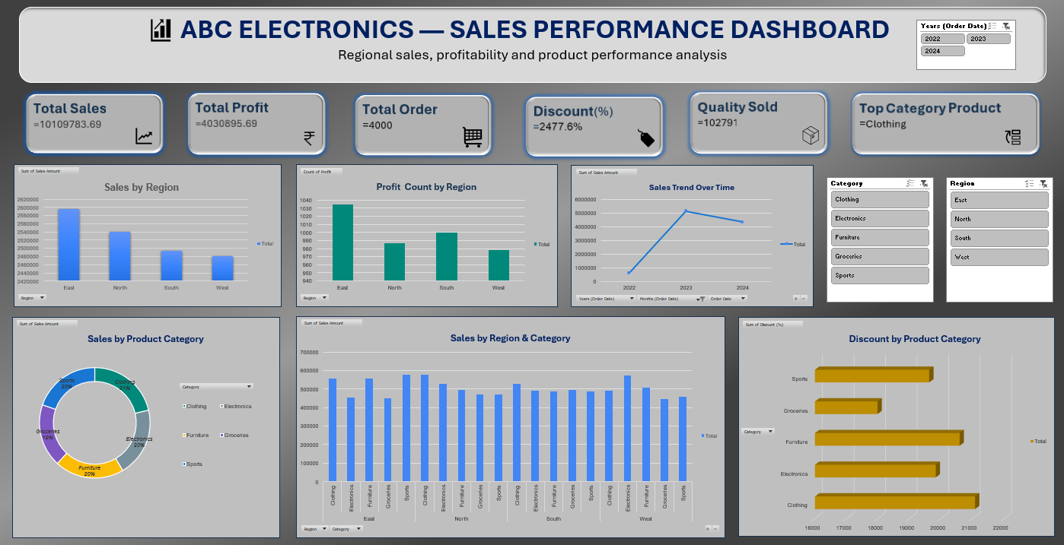
Results: Dashboard & Key Findings

Slide 7
Key Findings
Regional Performance
East recorded the highest sales, at approximately ₹2.50 million.
Category Performance
Clothing is the top-performing product category, contributing approximately 21% of total category sales.
Yearly Sales Trend
Sales increased sharply from 2022 to 2023, reaching the highest level in 2023, followed by a decline in 2024 while remaining above 2022.
Overall Performance
The business generated approximately ₹10.11 million in sales and ₹4.03 million in profit across 4,000 orders.

Slide 8
Project Evaluation
✓ Data Quality — Data cleaned and standardized ✓ Analysis — Formulas and PivotTables used for performance analysis ✓ Visualization — Charts highlight regional, category and time-based patterns ✓ Dashboard — KPIs, charts and interactive slicers integrated ✓ Documentation — Analysis steps and business insights documented
Conclusion
Raw Sales Data → Analysis → Visualization → Business Insights
Excel-based analysis provides a clear and interactive view of sales performance to support better business decision

Slide 9
Thank You

